Slide 1
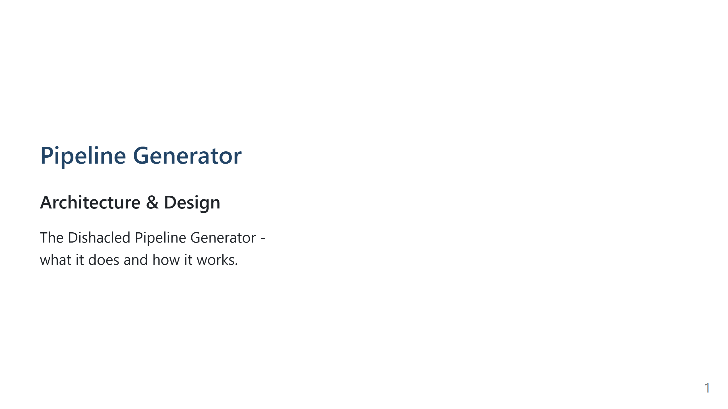
Notes:
Companion notes for the presenter. Assumes comfort with RDF, Turtle, SPARQL, rdflib. REPOSITORY CONTEXT - Location: toolchain-specification/pipeline generator/. Compilers under src/compilers/. End-to-end walkthrough in src/demo.ipynb. Sample catalog in data/catalog.ttl. - What it does: reads a pipeline definition and a component catalog (both RDF), assembles an in-memory build graph, emits a project folder with framework-specific configs and docker-compose.yml. - Target frameworks: RDF-Connect, LDIO, semantic.works. - rdfine (src/rdfine/): in-repo wrapper over rdflib exposing GraphReader (filter, traverse, select, construct, add). Used by every compiler. - tcs: namespace: tcs:PipelineBuild, tcs:DockerContainer, tcs:DockerComposeConfig, tcs:File, tcs:compiledFile, tcs:filename, tcs:filepath, tcs:literal, tcs:instantiates, tcs:runs. DECK STRUCTURE Problem, core idea, three design decisions, compiler set, roadmap. FALLBACK FRAMING For any deep implementation question: source-code compiler with an RDF graph in place of an AST. Inputs are RDF (definition + catalog); the intermediate representation is an RDF build graph; code generation is a set of small compilers that attach tcs:File nodes carrying the emitted text.

Slide 2
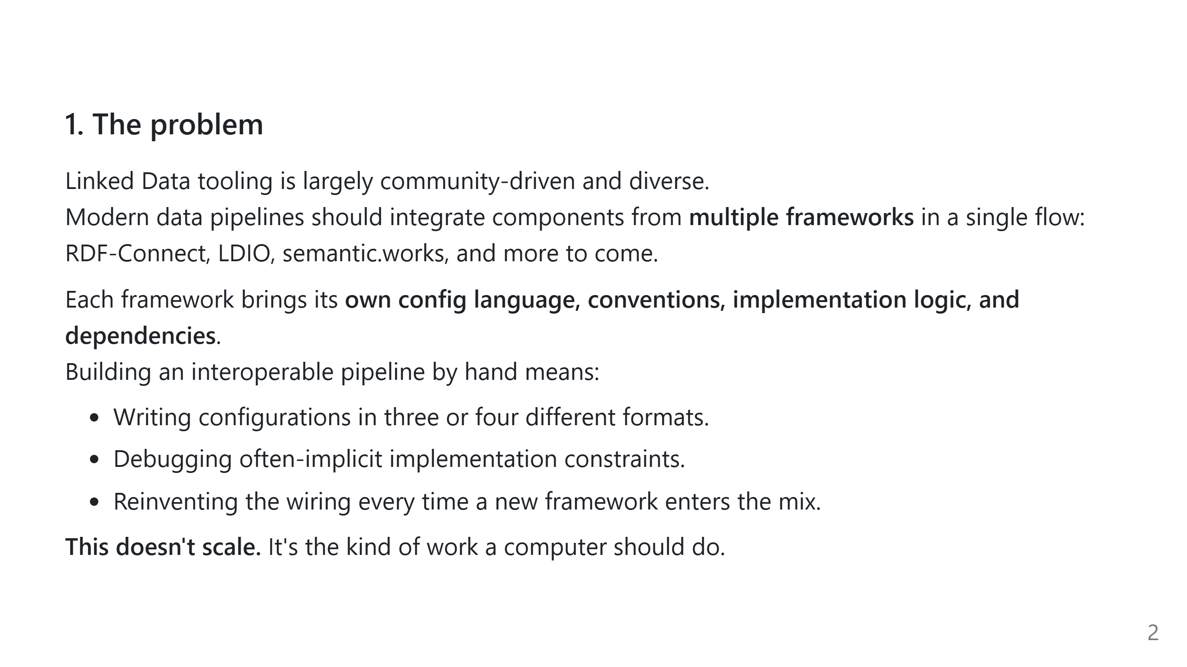
Notes:
SLIDE 1 - THE PROBLEM Mixing components from multiple frameworks (RDF-Connect, LDIO, semantic.works) currently requires hand-writing configs in several formats, working around implicit implementation constraints, and rewiring everything whenever the framework mix changes.

Slide 3
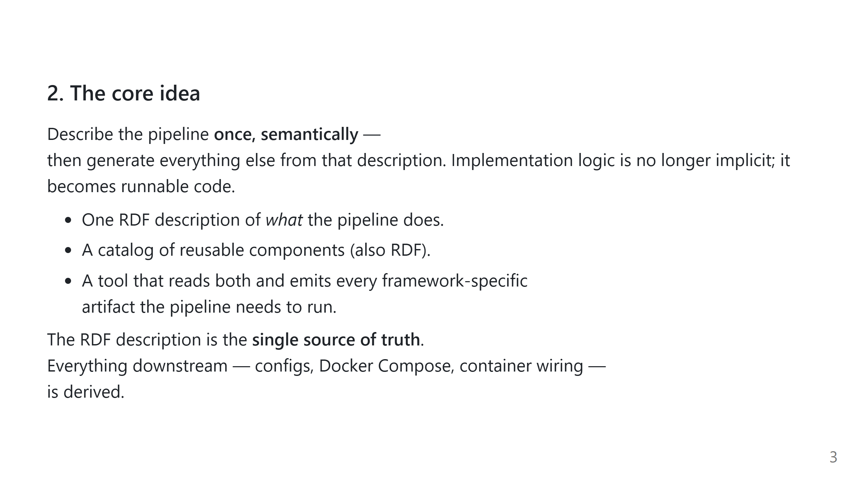
Notes:
SLIDE 2 - THE CORE IDEA One RDF description of the pipeline plus a component catalog (also RDF) are the single source of truth. Every framework-specific artifact is derived from them. Q: Why RDF for the internal build state and not a Python object model? A: The inputs are already RDF (public toolchain specification and the catalog); using RDF throughout avoids a translation layer, keeps the vocabulary extensible without schema migrations, and makes every intermediate inspectable with SPARQL.

Slide 4
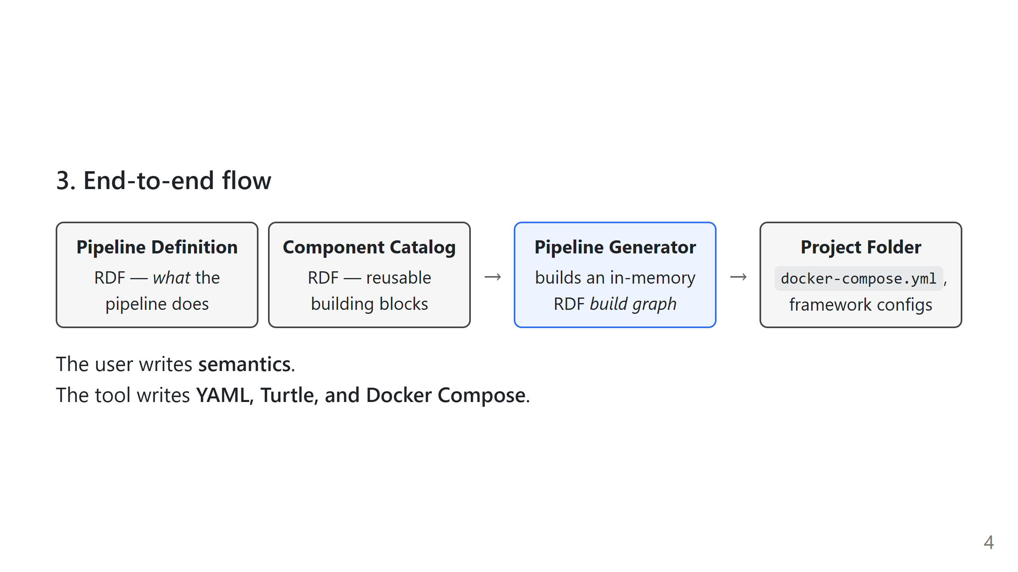
Notes:
SLIDE 3 - END-TO-END FLOW Two RDF inputs (pipeline definition + catalog) -> the generator, which builds an in-memory RDF build graph -> a project folder on disk. This is where the term "build graph" enters; it is used throughout the rest of the deck.

Slide 5
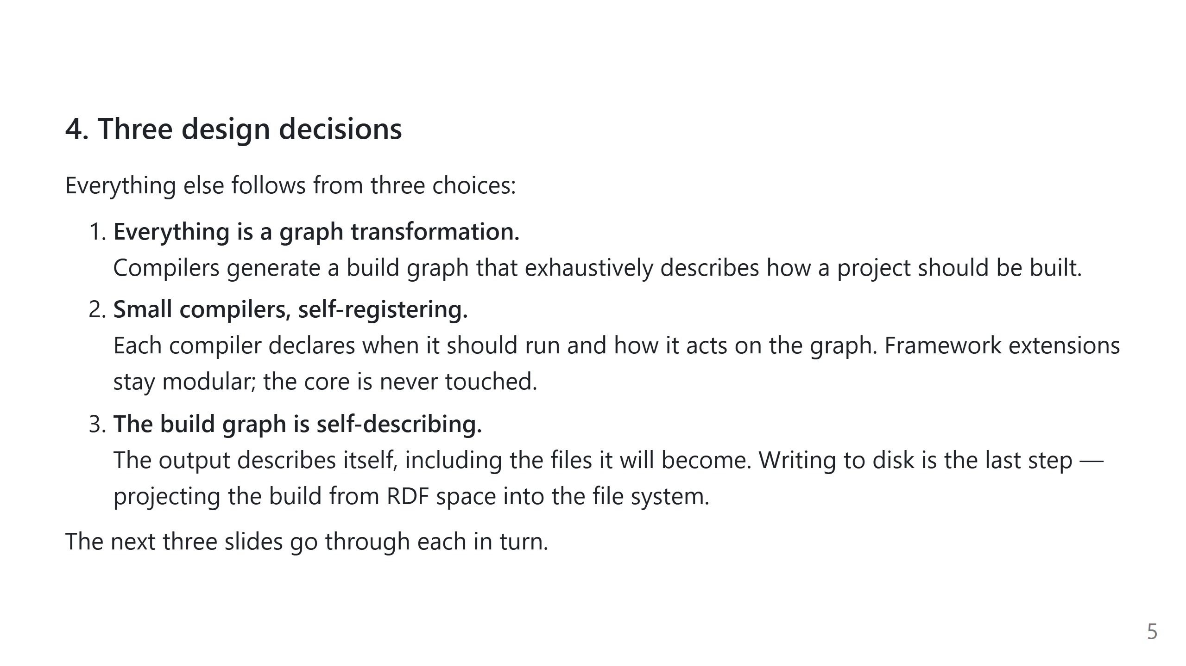
Notes:
SLIDE 4 - THREE DESIGN DECISIONS Signpost slide. Three decisions: (1) generation as graph transformation, (2) small self-registering compilers, (3) a self-describing build graph. Each is unpacked on the following slide.

Slide 6
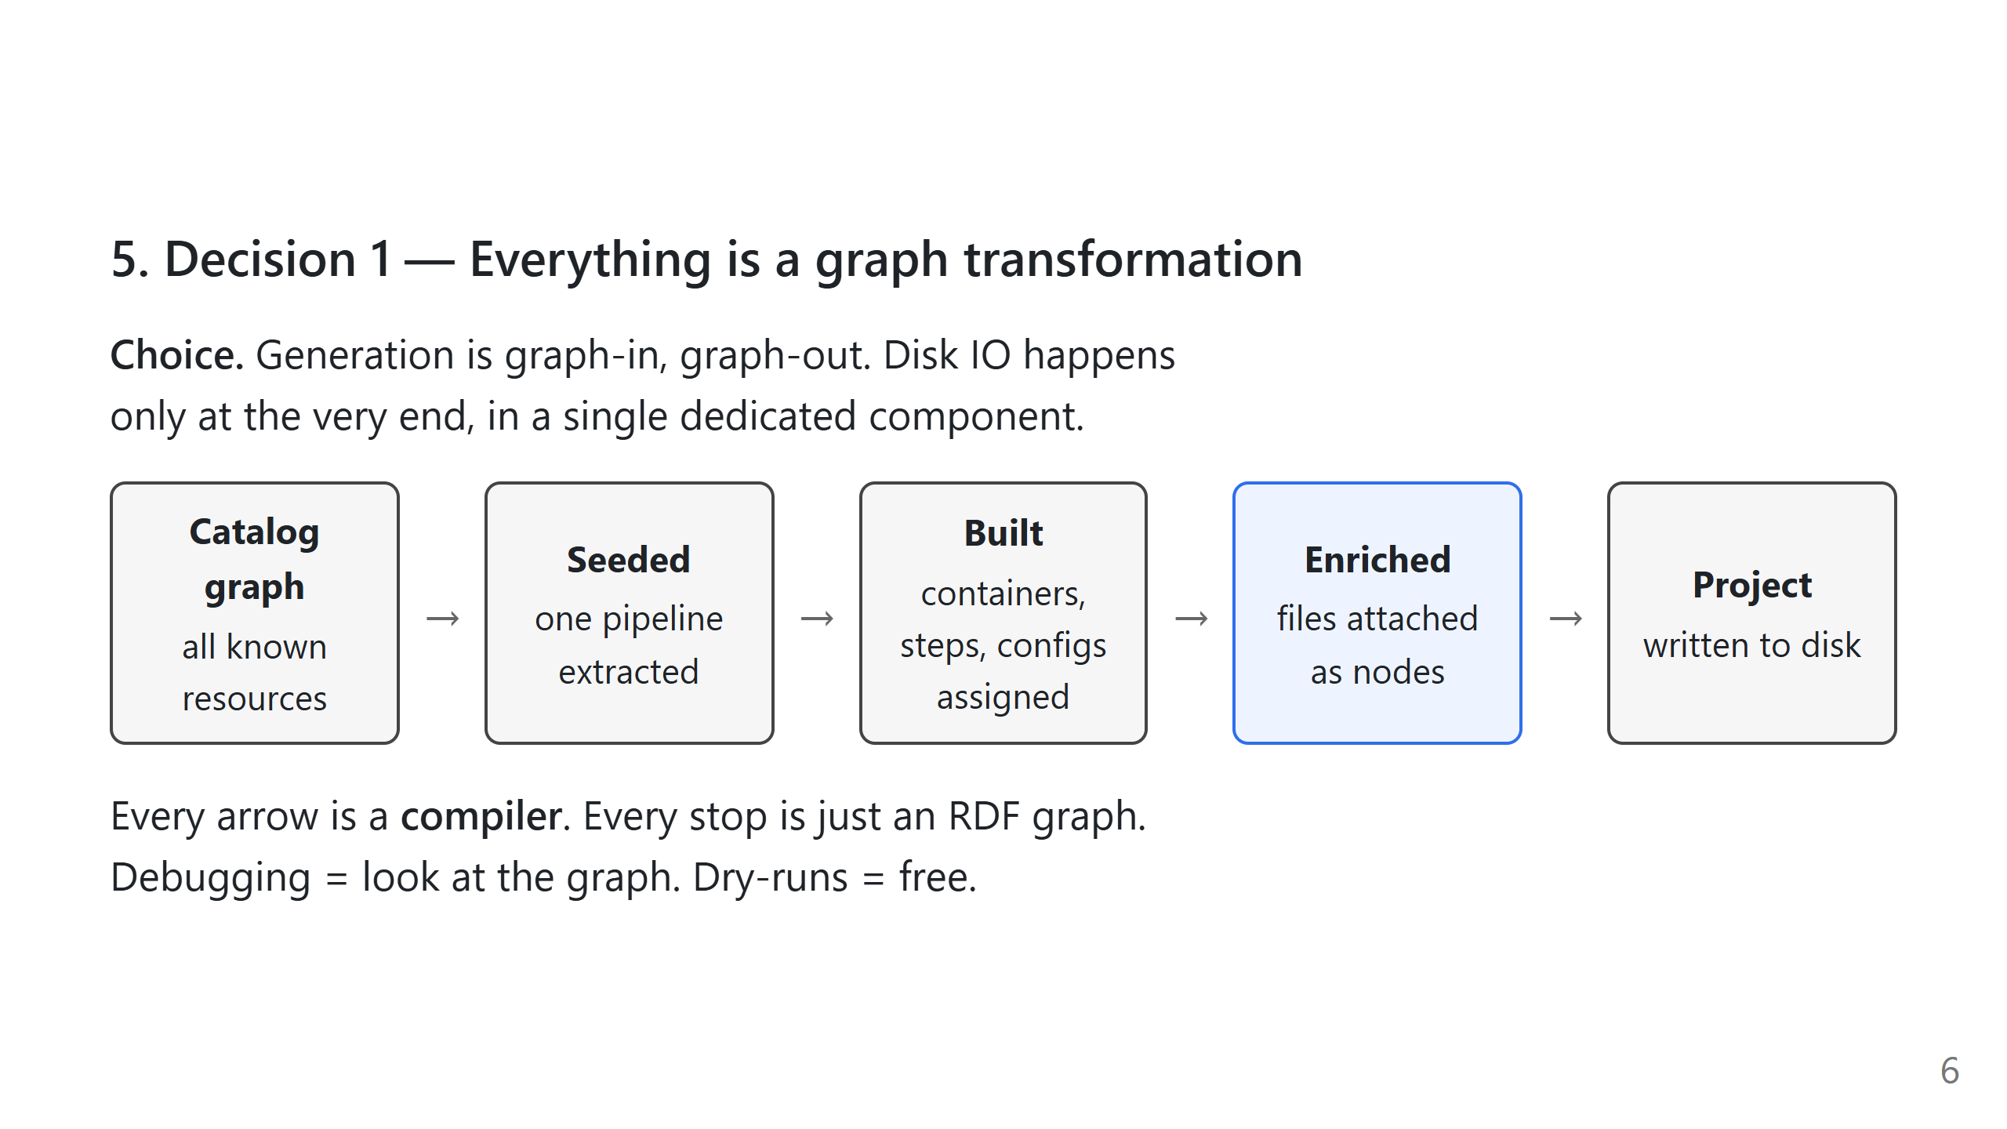
Notes:
SLIDE 5 - DECISION 1: EVERYTHING IS A GRAPH TRANSFORMATION - Every compiler takes an rdflib.Graph and returns an enriched rdflib.Graph. The only I/O happens in ProjectBuilder, which is not a Compiler subclass. - The five-stop diagram sequences the graph's states: catalog -> seeded (extractor) -> built (assembler and any BUILD-tier compilers) -> enriched with file nodes (FILE-tier compilers) -> written to disk. - Because every intermediate is a graph, inspection at any stage is a matter of calling .compile() and looking at the result.

Slide 7
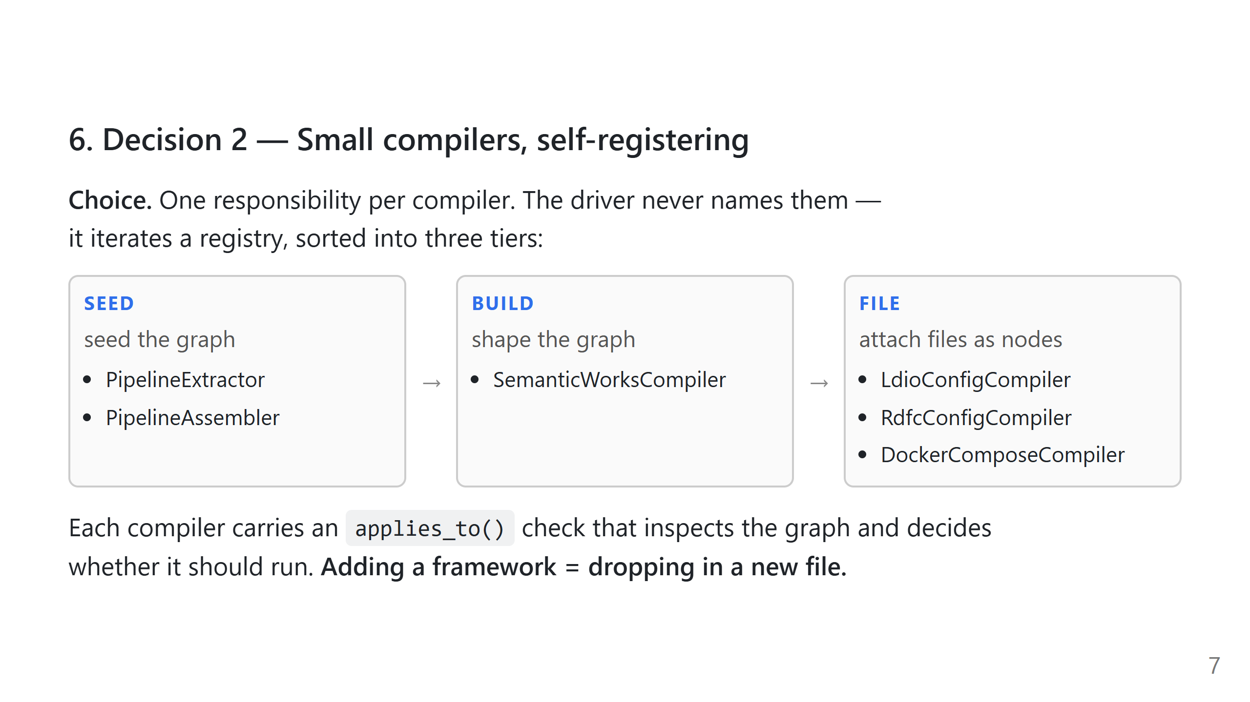
Notes:
SLIDE 6 - DECISION 2: SMALL COMPILERS, SELF-REGISTERING - Concrete compilers subclass Compiler in src/compilers/base.py. Compiler.__init_subclass__ appends every non-abstract subclass to Compiler._registry; the driver iterates that registry sorted by Tier. There is no explicit compiler list in the driver. - Tiers: SEED (extractor + assembler, always run first and unconditionally), BUILD (shape the graph, e.g. SemanticWorksCompiler), FILE (attach a tcs:File node - the LDIO, RDF-Connect, and Docker Compose compilers). - Each compiler defines an applies_to(graph_reader) classmethod that inspects the build graph and returns a boolean. Default is True. FILE-tier compilers typically override with a single filter check (e.g. "is there a container instantiating the LDIO orchestrator?"). - Adding a framework: drop a new Compiler subclass into src/compilers/, import it from compilers/__init__.py. The driver is not touched. Q: How is compiler ordering guaranteed within a tier? A: It isn't. Compilers in the same tier must be commutative. In practice each FILE-tier compiler operates on a disjoint slice of the build graph selected by its applies_to check. Q: How does the driver know what to run? A: Compiler.__init_subclass__ populates the class-level registry on import. PipelineGenerator runs the two SEED compilers unconditionally, then iterates the remaining registry sorted by tier, calling each compiler's applies_to and invoking those that return True.

Slide 8
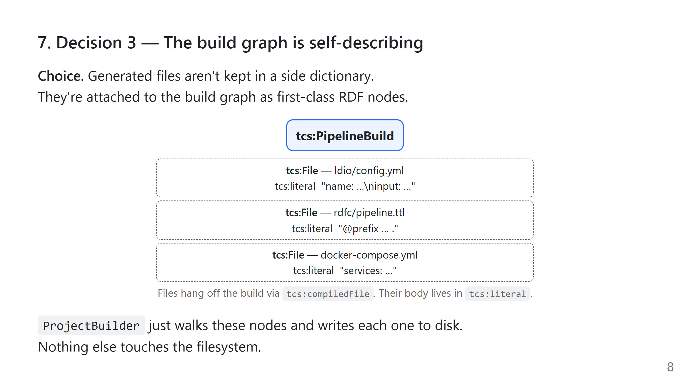
Notes:
SLIDE 7 - DECISION 3: THE BUILD GRAPH IS SELF-DESCRIBING - FILE-tier compilers do not return paths or strings. They call self._attach_file(filename, filepath, content) from inside _compile(), which adds a tcs:File node to the build graph and links it to the tcs:PipelineBuild via tcs:compiledFile. The file body is stored on tcs:literal. - The file-node IRI is derived by slugifying filepath_filename, so the same (filepath, filename) pair yields a stable IRI across runs. - ProjectBuilder reads the tcs:File nodes off the compiled build graph and writes them to disk. Planned writes are collected into a pandas.DataFrame on builder.files first, so they can be inspected without touching the filesystem. A path-traversal guard rejects any tcs:filepath that would escape the target directory. - Consequence: a compiled build is a single serializable RDF artifact. Provenance, caching, diffing, and replay reduce to graph operations. Q: Why bake file bodies into the graph as tcs:literal rather than side-tables? A: So the compiled build is a single serializable artifact. Provenance, caching, diffing, and replay become graph operations; ProjectBuilder stays trivial.

Slide 9
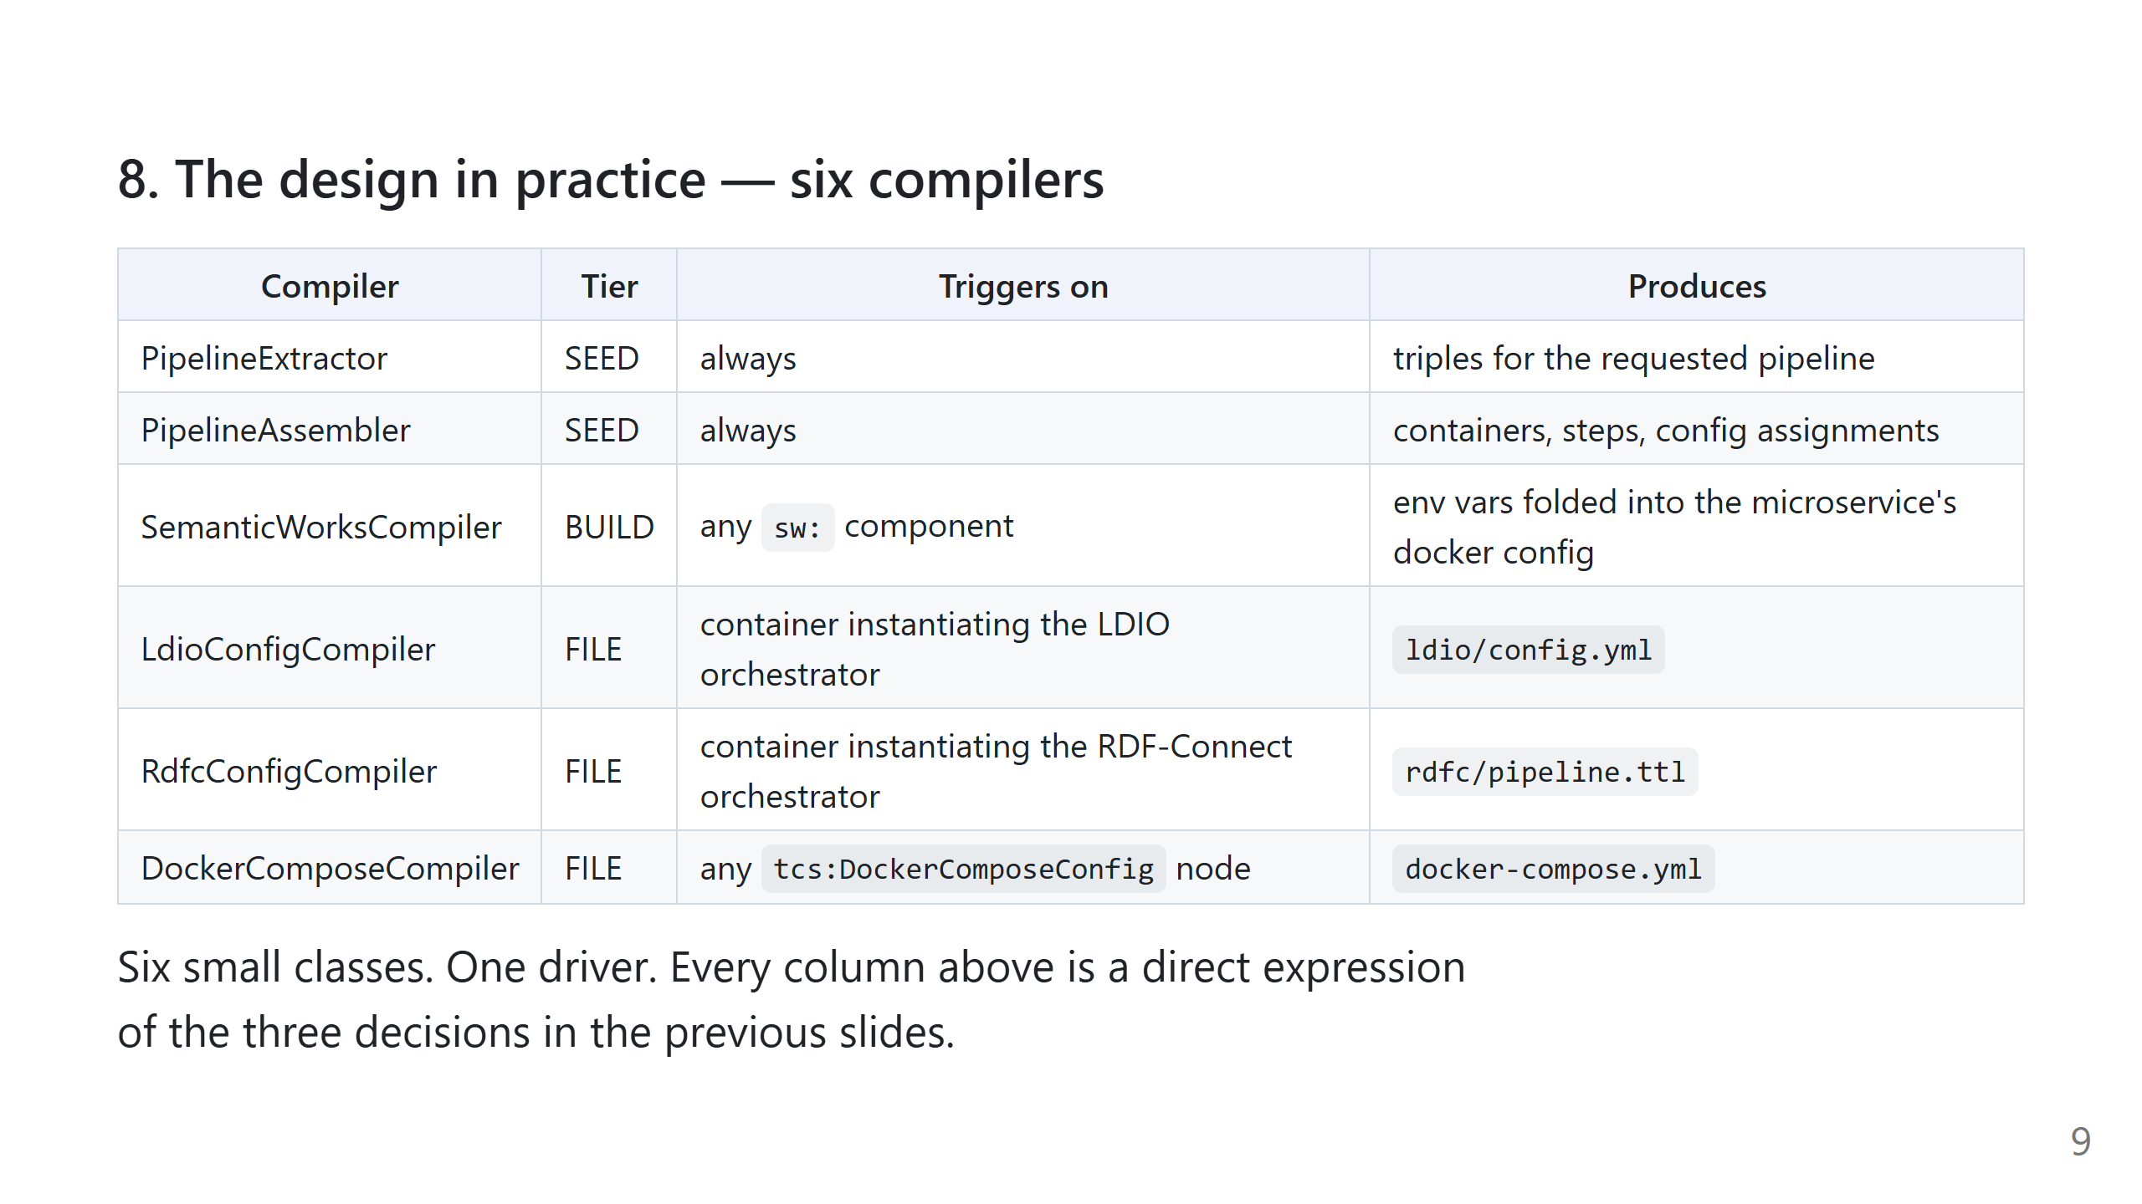
Notes:
SLIDE 8 - THE DESIGN IN PRACTICE The six-row table lists every concrete compiler with its tier, trigger, and output. The two SEED compilers (PipelineExtractor, PipelineAssembler) are excluded from registry dispatch and hard-wired at the top of PipelineGenerator.compile(); every other compiler is discovered via the registry. VOCABULARY (for reference) - Pipeline Definition: RDF description of a data pipeline, expressed against the public semantic model. - Component / Catalog: a component is a reusable pipeline building block; the catalog is the RDF library of all available components (data/catalog.ttl). - Build graph: the in-memory rdflib.Graph the generator assembles. All build state lives here. - tcs:PipelineBuild: root node of a build graph. Generated files hang off it via tcs:compiledFile. - tcs:File: RDF node representing a generated file. Carries tcs:filename, tcs:filepath, tcs:literal (the body). - Compiler: subclass in src/compilers/. Takes the build graph, transforms it, returns it. Registers automatically on import. - Tier: Tier.SEED / Tier.BUILD / Tier.FILE. Sequences the compilers; within a tier, ordering must not matter. - applies_to: classmethod on every compiler. Decides whether the compiler should run against a given build graph. - rdfine / GraphReader: in-repo wrapper over rdflib used by every compiler. - ProjectBuilder: the filesystem boundary. Walks the tcs:File nodes and writes them out. Q: What happens when two frameworks share a container arrangement? A: Each framework compiler emits its own config file. They meet in docker-compose.yml, produced by a single framework-agnostic DockerComposeCompiler that reads every tcs:DockerComposeConfig node. Q: How is this tested? A: Every compiler is a graph-in / graph-out function, so unit tests are graph fixtures with assertions on the output graph. src/demo.ipynb is the end-to-end reference.

Slide 10
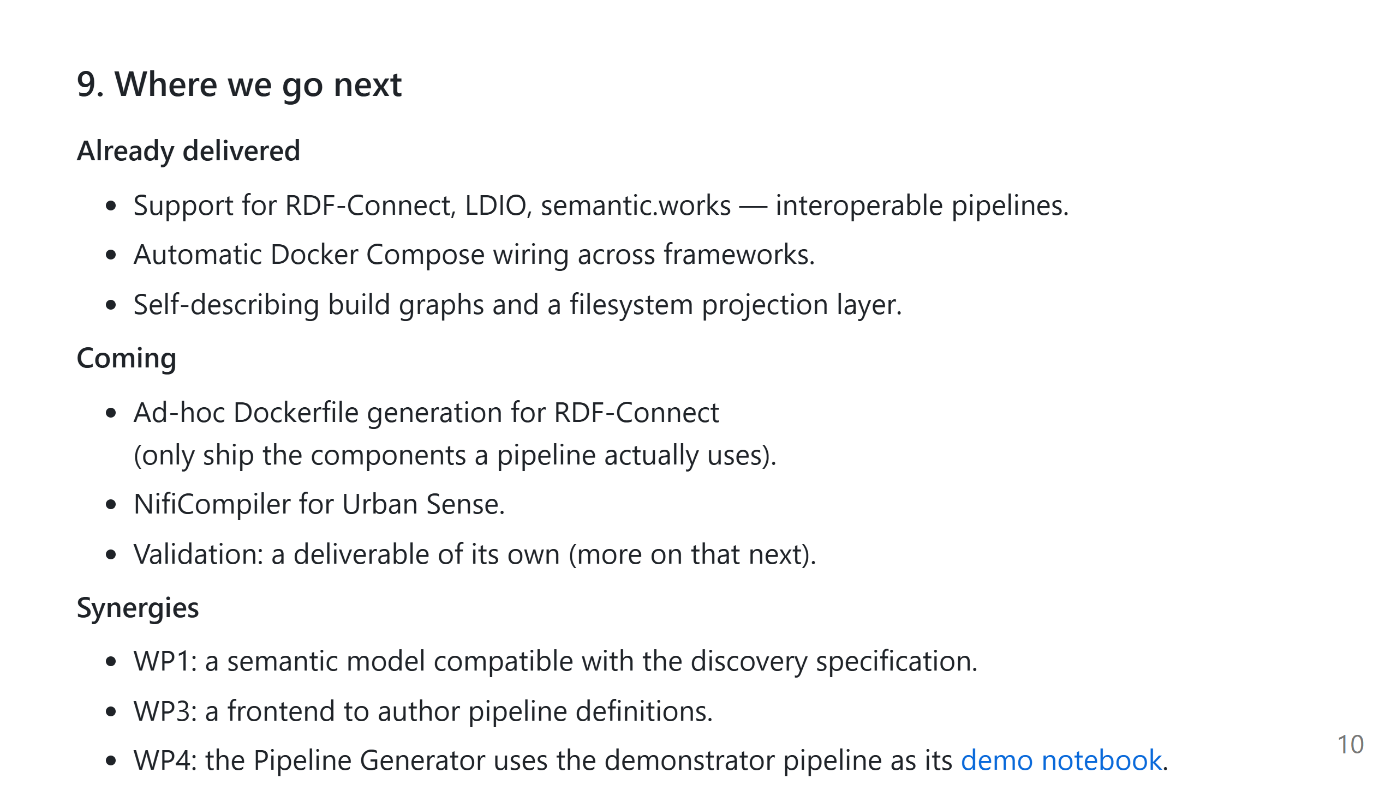
Notes:
SLIDE 9 - WHERE WE GO NEXT - Already delivered: multi-framework interoperability (RDF-Connect + LDIO + semantic.works), automatic Docker Compose wiring across frameworks, self-describing build graphs, filesystem projection. - Coming: ad-hoc Dockerfile generation for RDF-Connect (ship only the components a pipeline actually uses); NifiCompiler for Urban Sense; validation as a separate deliverable. - Synergies: WP1 discovery-compatible semantic model, WP3 authoring frontend, WP4 uses demo.ipynb as its demonstrator pipeline.

